Slide 1
THE NEXT MORNING

Slide 2
Submitted By:
Name | ID
SK MUKTADIR HOSSAIN | 21-44989-2
PRANTO BISWAS | 21-45026-2
ISTAHAD RADOWAN | 21-44669-1
MAHMUDUL HAQUE SHAKIR | 21-45016-2
Supervised By
Dr. S.M. HASAN Mahmud

Slide 3
THE NEXT MORNING

Slide 4
Contents:
1. Case study
2. ER diagram
3. Normalization
4. Table creation with constraints
5. Data insertion
6. Query writings based on the tables
7. Application

Slide 5
Case study
1.cloud-based task management database application
2. manage their tasks from a smartphone, tablet and computer.
3. The system consists of entities each one with various attributes

Slide 6
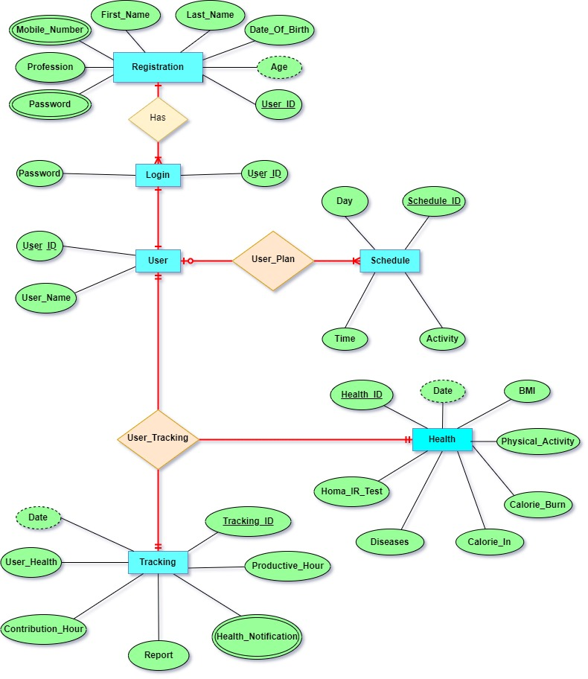
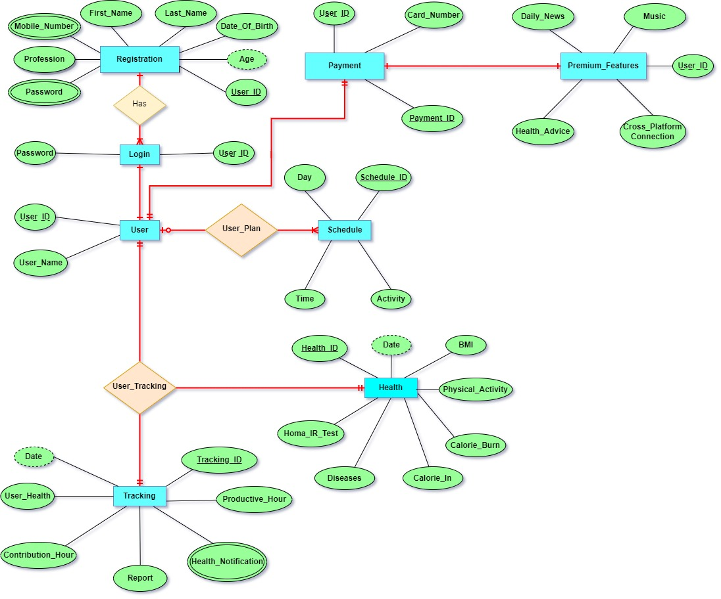
2.ER diagram
Beta version
Updated version
→

Slide 7
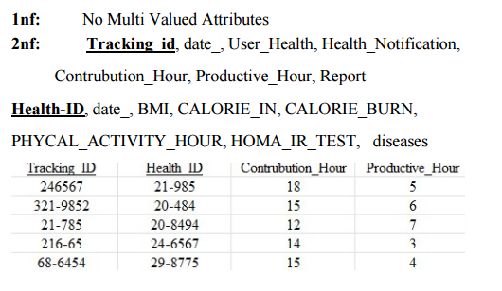
Normalization

Slide 8
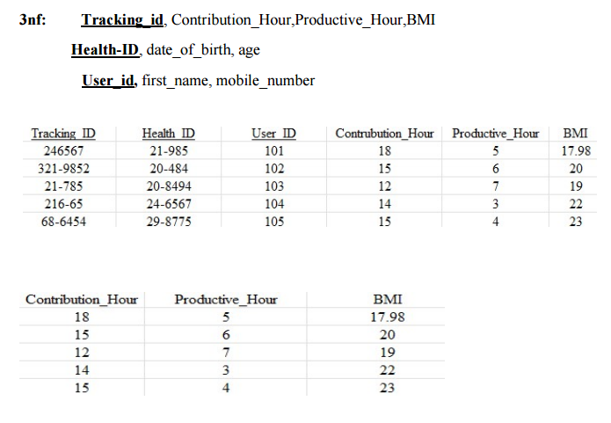
Normalization

Slide 9
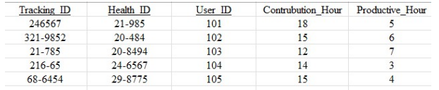
Normalization
So Tables from TRACKING are : Tracking_id, Contrubution_Hour,
Productive_Hour,Health-ID, date, BMI, user_id, first_name,
mobile_number.

Slide 10
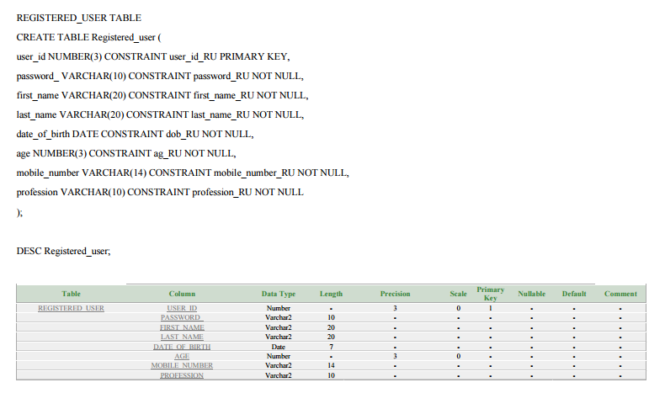
Table creation with constraints

Slide 11
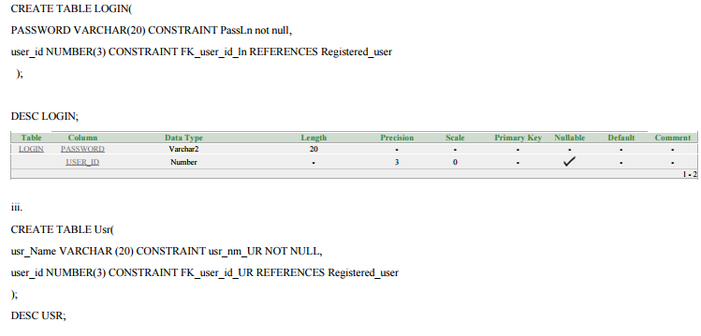
Table creation with constraints

Slide 12
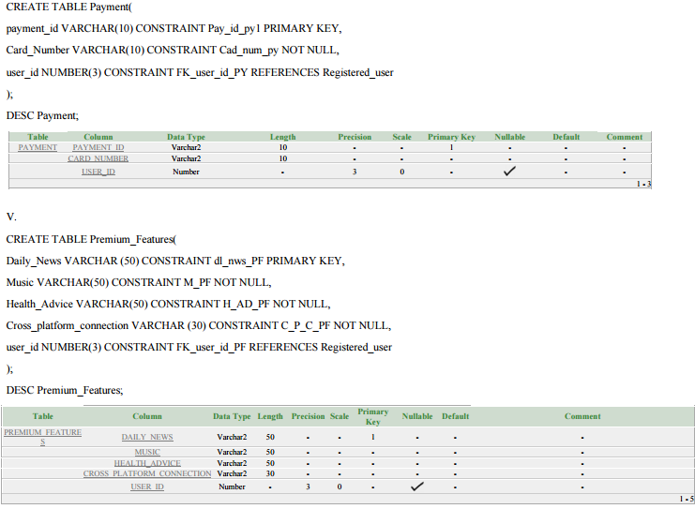
Table creation with constraints

Slide 13
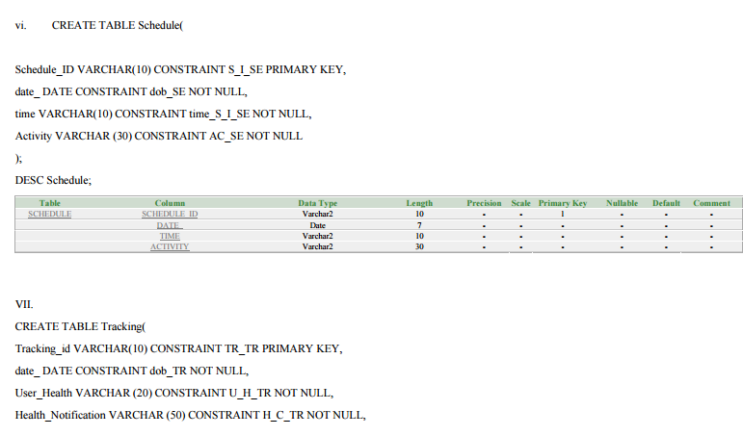
Table creation with constraints

Slide 14
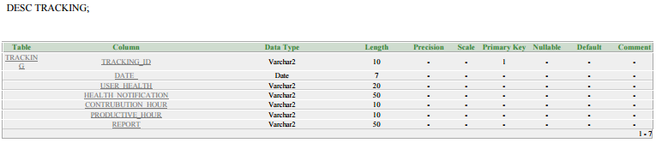
Table creation with constraints
VII.
CREATE TABLE Tracking(
Tracking_id VARCHAR(10) CONSTRAINT TR_TR PRIMARY KEY,
date_ DATE CONSTRAINT dob_TR NOT NULL,
User_Health VARCHAR (20) CONSTRAINT U_H_TR NOT NULL,
Health_Notification VARCHAR (50) CONSTRAINT H_C_TR NOT NULL,
Contrubution_Hour VARCHAR(10) CONSTRAINT C_H_TR NOT NULL,
Productive_Hour VARCHAR (10) CONSTRAINT P_H_TR NOT NULL,
Report VARCHAR (50) CONSTRAINT Rp_TR NOT NULL
);

Slide 15
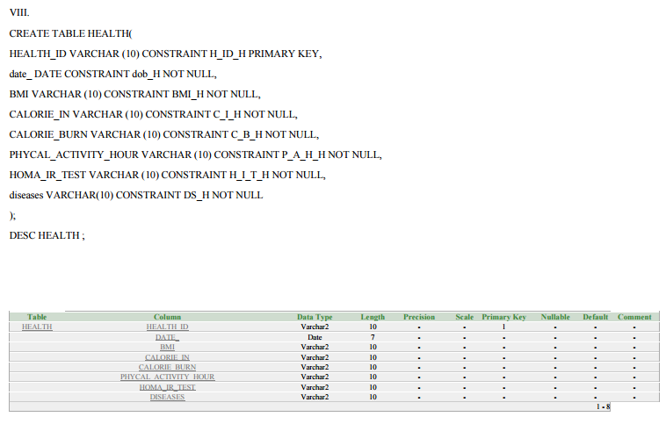
Table creation with constraints

Slide 16
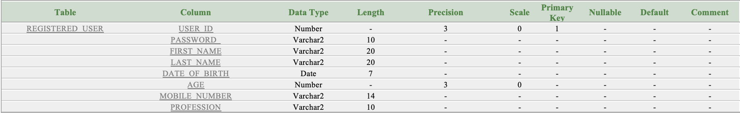
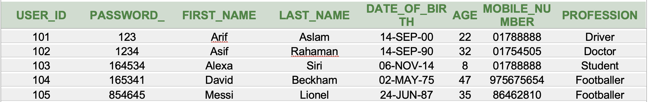
Data Insert
Registered_user table data insert
INSERT INTO Registered_user VALUES
(101,'123','Arif','Aslam',to_date('14-09-2000','dd-mm-yyyy'),22,'01788888','Driver’)
INSERT INTO Registered_user VALUES(102,'1234','Asif','Rahaman',to_date('14-09-1990', 'dd-mm-yyyy'),32,'01754505','Doctor’)
INSERT INTO Registered_userVALUES
(103,'164534','Alexa','Siri',to_date('6-11-2014','dd-mm-yyyy'),8,'01788888','Student')
INSERT INTO Registered_user VALUES
(104,'165341','David','Beckham',to_date('2-5-1975','dd-mm-yyyy'),47,'975675654','Footballer')
INSERT INTO Registered_user VALUES
(105,'854645','Messi','Lionel',to_date('24-6-1987','dd-mm-yyyy'),35,'86462810','Footballer')
SELECT *
FROM Registered_user

Slide 17
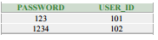
Login Table
INSERT INTO Login
VALUES
('123',101)
INSERT INTO Login
VALUES
('1234',102)
INSERT INTO Login
VALUES
('164534',103)
INSERT INTO Login
VALUES
('165341',104)
INSERT INTO Login
VALUES
('854645',105)
SELECT *
FROM LOGIN

Slide 18
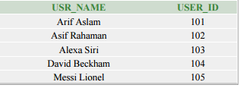
3
INSERT INTO USR
VALUES
('Arif Aslam',101)
INSERT INTO USR
VALUES
('Asif Rahaman',102)
INSERT INTO USR
VALUES
('Alexa Siri',103)
INSERT INTO USR
VALUES
('David Beckham',104)
INSERT INTO USR
VALUES
('Messi Lionel',105)
SELECT *
FROM USR

Slide 19
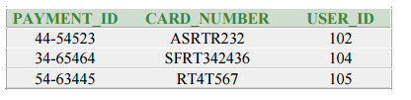
4
INSERT INTO PAYMENT
VALUES
('44-54523','ASRTR232',102)
INSERT INTO PAYMENT
VALUES
('34-65464','SFRT342436',104)
INSERT INTO PAYMENT
VALUES
('54-63445','RT4T567',105)
SELECT *
FROM PAYMENT

Slide 20
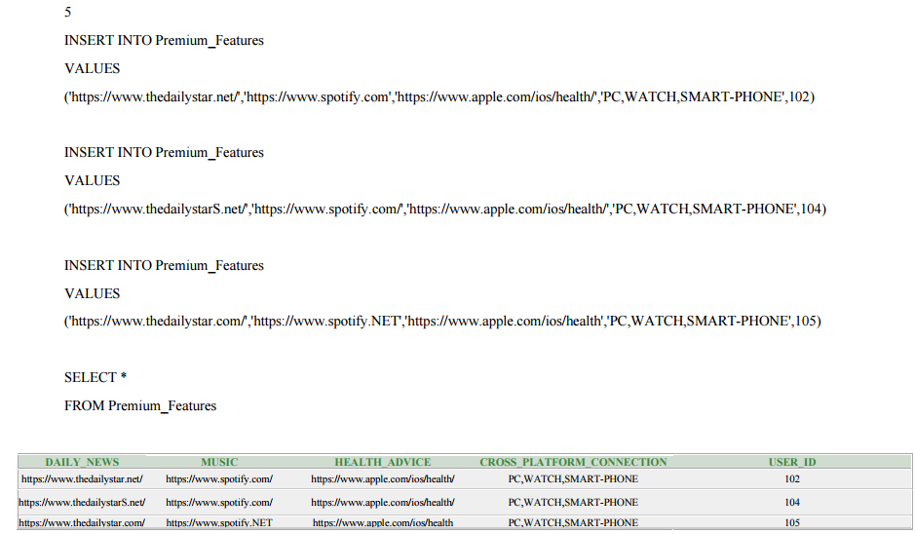

Slide 21
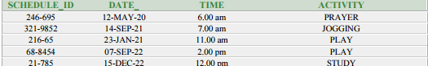
6
INSERT INTO schedule
VALUES
('246-695',to_date('12-5-2020','dd-mm-yyyy'),'6.00 am', 'PRAYER')
INSERT INTO schedule
VALUES
('321-9852',to_date('14-09-2021','dd-mm-yyyy'),'7.00 am', 'JOGGING')
INSERT INTO schedule
VALUES
('21-785',to_date('15-12-2022','dd-mm-yyyy'),'12.00 pm', 'STUDY’)
INSERT INTO schedule
VALUES
('216-65',to_date('23-01-2021','dd-mm-yyyy'),'11.00 am', 'PLAY')
INSERT INTO schedule
VALUES
('68-8454',to_date('7-09-2022','dd-mm-yyyy'),'2.00 pm', 'PLAY' )
SELECT *
FROM schedule

Slide 22
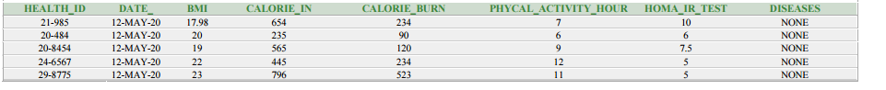
INSERT INTO HEALTH
VALUES
('21-985',to_date('12-5-2020','dd-mm-yyyy'),'17.98','654','234','7','10','NONE')
INSERT INTO HEALTH
VALUES
('20-484',to_date('12-5-2020','dd-mm-yyyy'),'20','235','90','6','6','NONE’)
INSERT INTO HEALTH
VALUES
('20-8454',to_date('12-5-2020','dd-mm-yyyy'),'19','565','120','9','7.5','NONE')
INSERT INTO HEALTH
VALUES
('24-6567',to_date('12-5-2020','dd-mm-yyyy'),'22','445','234','12','5','NONE')
INSERT INTO HEALTH
VALUES
('29-8775',to_date('12-5-2020','dd-mm-yyyy'),'23','796','523','11','5','NONE')
SELECT *
FROM HEALTH

Slide 23
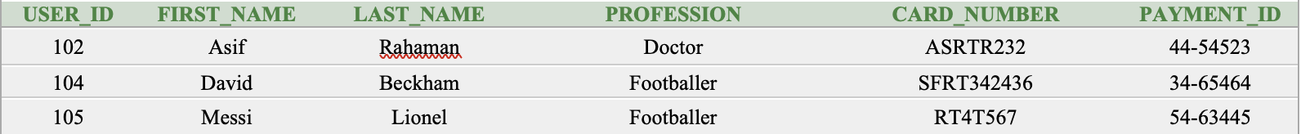
JOINING TABLE Registered_user AND Payment
SELECT Registered_user.USER_ID,Registered_user.FIRST_NAME,Registered_user.LAST_NAME,
Registered_user.PROFESSION,Payment.Card_Number,Payment.payment_id
FROM Registered_user, Payment
WHERE Registered_user.USER_ID=Payment.USER_ID

Slide 24
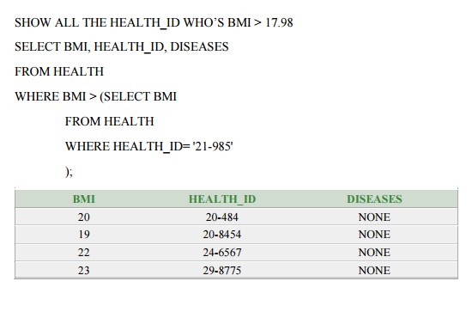
Sub-Query

Slide 25
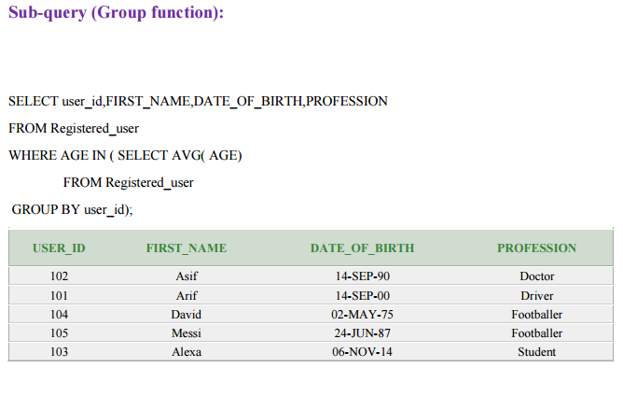
Sub-Query

Slide 26
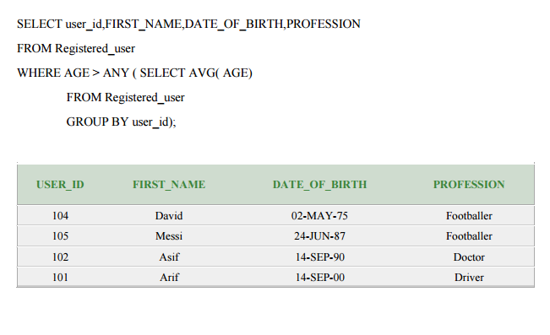
Sub-Query

Slide 27
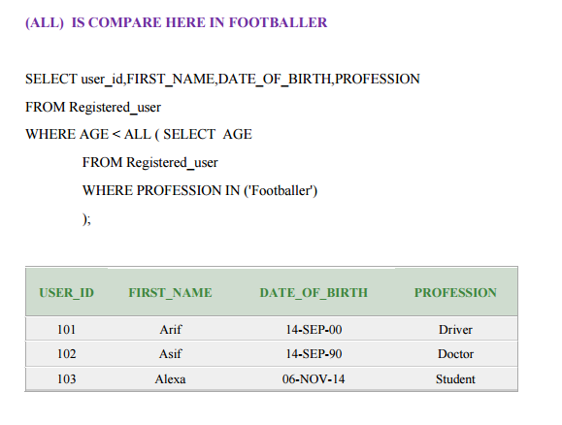
Sub-Query

Slide 28
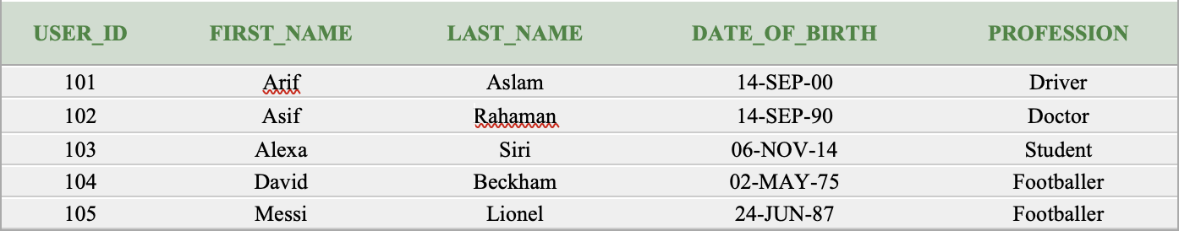
Create View
Registration table
CREATE VIEW REGISTERED_USER_VIEW
AS SELECT USER_ID,FIRST_NAME,LAST_NAME,DATE_OF_BIRTH,PROFESSION
FROM Registered_user
SELECT*
FROM REGISTERED_USER_VIEW

Slide 29
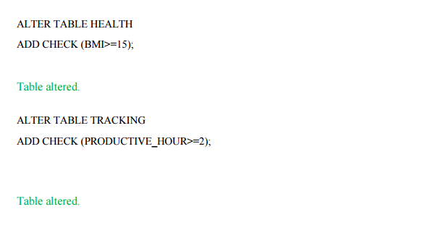
Constraints

Slide 30

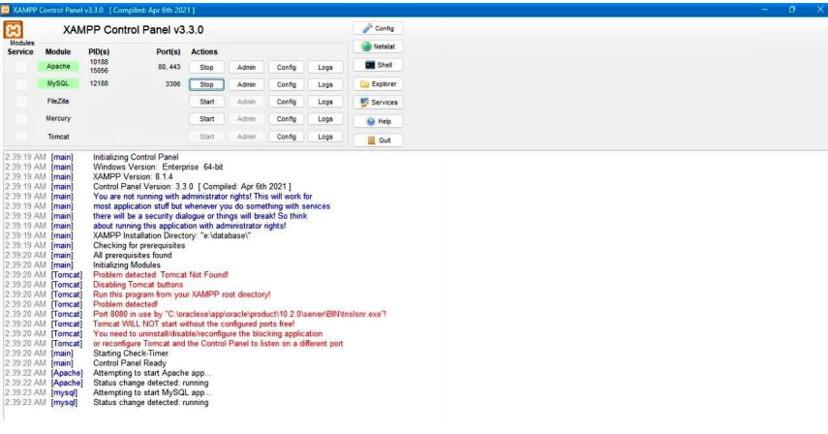
Application
Using XAMPP

Slide 31
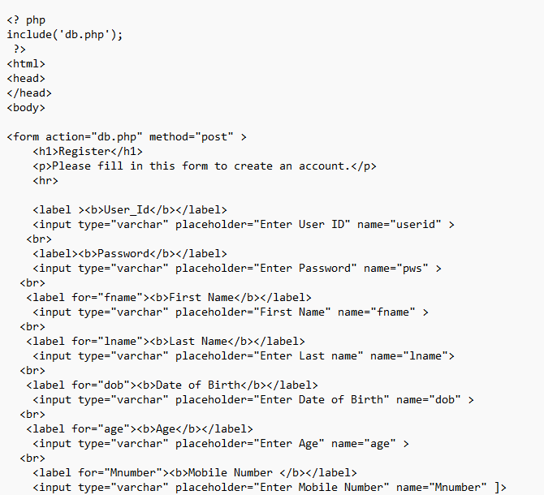
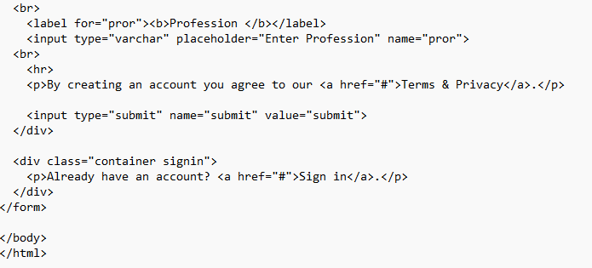
html

Slide 32
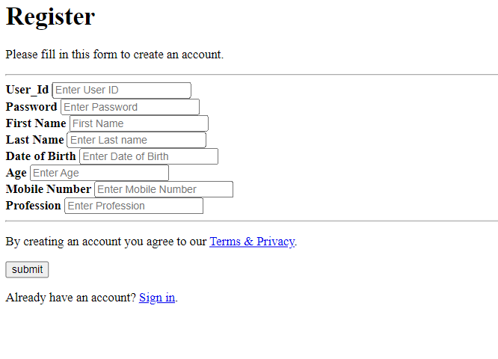
html

Slide 33
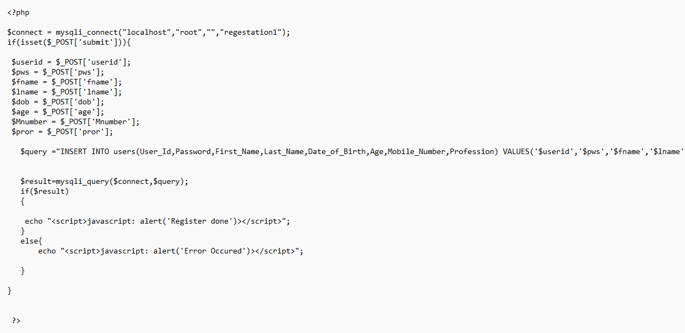
php

Slide 34
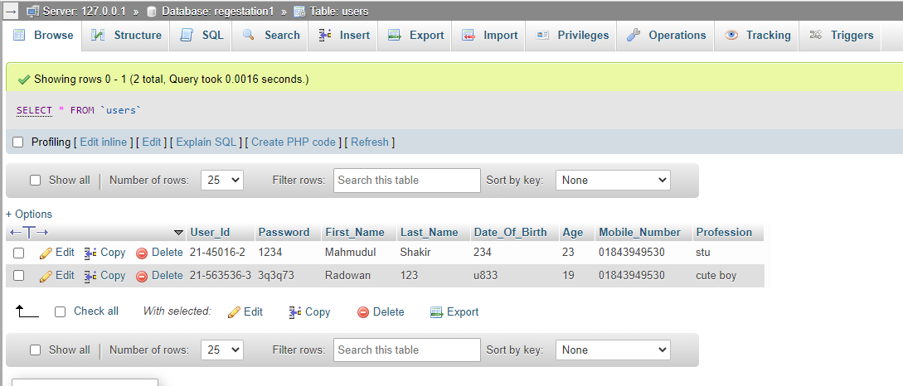
DATABASE

Slide 35
Thank you

